Slide 1
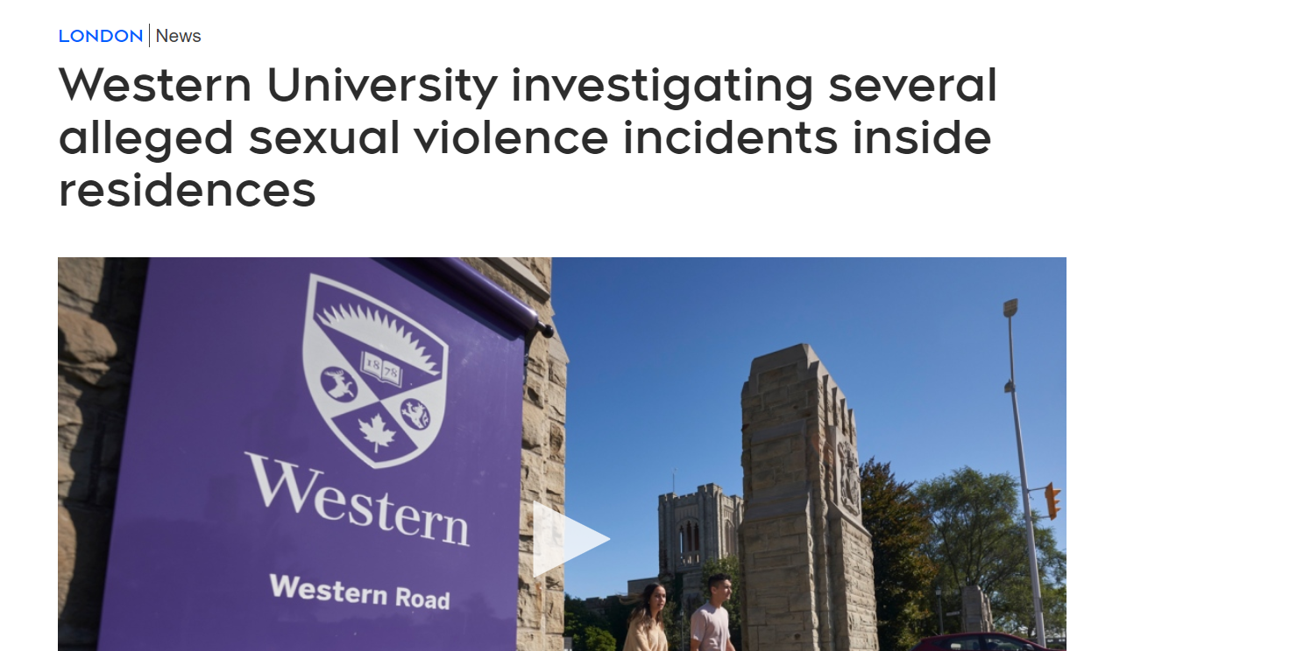
TW: Sexual Assault, Violence

Slide 5
35.3% of undergraduate respondents reported that within the past 12 months they “felt so depressed that it was difficult to function.” Nearly 10% reported that they “seriously considered suicide” within the past year (ACHA, 2015).
Graduate students show a rate of depression six times that of the general population (Evans et al., 2018), 43%–46% of graduate student respondents in the sciences were depressed (UC Berkeley Graduate Assembly, 2014).
Faculty, too, are struggling: Depression, anxiety, suicidal ideation, boredom, unfulfillment, dissatisfaction, frustration, dread, despair, difficulty concentrating, lack of motivation, irritability, decreased compassion, sadness, and somatic symptoms like frequent headaches, GI upset, muscle aches, heart attacks, and hypertension are but a few of the symptoms faculty report as being caused or significantly exacerbated by the working conditions and cultures of academia (Lashuel, 2020; Nature 2018; The Chronicle of Higher Education (2016)).
Mental health stigma persist, so what are the actual numbers?

Slide 6
2 | CHANGES IN HIGHER EDUCATION
It is important to recognize that while mental health concerns in academia may be experienced as highly individualized, they are tied to larger structural factors.
Universities have adopted a business-oriented model, making them more more hierarchical and bureaucratic
“institutions are under increasing pressure to quantify and measure the value created by human capital against predetermined metrics in order to show a desirable return on investment in higher education.” (Kwok (2018, p. 5))
Increase cost of living
Lower salaries
Tuition
Securing funding

Slide 7
2 | CHANGES IN HIGHER EDUCATION
It is important to recognize that while mental health concerns in academia may be experienced as highly individualized, they are tied to larger structural factors.
Universities have adopted a business-oriented model, making them more more hierarchical and bureaucratic
“institutions are under increasing pressure to quantify and measure the value created by human capital against predetermined metrics in order to show a desirable return on investment in higher education.” (Kwok (2018, p. 5))
Satisfaction?
Are students customers?
Increase cost of living
Lower salaries
Tuition
Family responsibilities

Slide 8
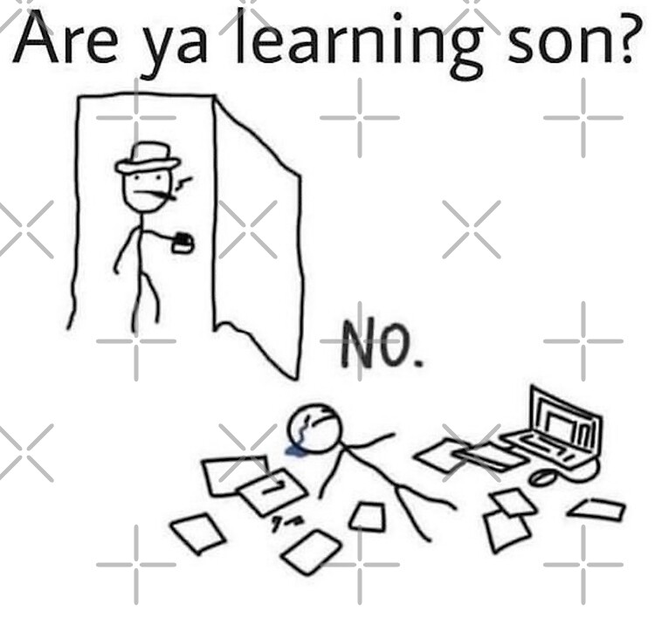
2.1 | The COVID effect
Primary intensifier of the ongoing mental health crisis.
Marroquín et al. (2020) report that stay-at-home orders and social distancing measures are associated with increases of anxiety and depression symptoms.
Faculty have likewise encountered increased stressors. Women faculty have shouldered more of the burdens of both professional and personal responsibilities during this time (Buckle, 2020; Kowal, et al., 2020) with potentially significant ramifications for research productivity and career advancement. Faculty of color, too, have had to contend with additional stressors as the COVID-19 crisis converged with existing health disparities

Slide 9
2.2 | Existing initiatives
Examples at the University of Windsor

Slide 10
2.3 | Student-specific issues
2.3.1 | Financial hardships
University tuition has increased by 37% from 2008 to 2018 while funding has decreased by 13% thus shifting the costs onto students (Mitchell et al., 2019).
Student debt
Food insecurity
Housing
2.3.2 | Post-degree job uncertainty
For many students, job prospects post-graduation are uncertain.
- Increase competition can lead to overworking
2.3.3 | Course themes
Confront ideas that are novel to them or contradict their own deeply held beliefs.
POC students must contend with a curriculum that is largely dominated by White discourse in which Black and Indigenous perspectives are erased or suppressed (Begum & Saini, 2019; Sium et al., 2012).

Slide 11
2.4 | Faculty-specific issues
One of the most notable consequences of recent structural and governance changes in academia has been the shift toward reliance on contingent faculty (adjunct and contract faculty not on the tenure track) and the diminishing availability of tenure track positions.
2.4.1 | Contingent faculty
Field and Jones (2016) define contingent faculty as “sessional faculty and all nonpermanent faculty members who are working on part-time or limited term contracts outside the tenure-stream” → lack of support and resources
2.4.2 | Tenure-track faculty
Pre-tenure track have no job security. Stress of environment (publish or perish, grants): “proving yourself”
Mid-career, increased responsibility and expectations (mid-career crisis)
Senior (professor-level) frees of promotion pressure, but additional responsibilities and
2.4.3 | Cultures of overwork can mask serious concerns
The messages many receive from mentors or colleagues about how to manage the stress, anxiety, and pressure associated with academic life often involve some version of “work harder,” “focus more on productivity,” or “be grateful for the flexibility of academia.”

Slide 12
3.1 | Daily hacks
3.1.1 | Get organized
Good organization can help reduce the anxiety, stress, and overwhelm that can arise from multiple commitments, varied deadlines, and overfull schedules
Isabelle rate’s this hack:
Having a routine helps, but it is easier said than done. Start small – make a list, cross off as you go. Be realistic with your goals. Be kind with yourself.

Slide 13
3.1.2 | Build networks
Whether these networks are academic in nature or are based instead in shared interests or leisure pursuits, building and sustaining networks within academia (as well as outside) can offer substantial supports.
Isabelle rate’s this hack:
You are not alone. Reaching out is the hardest part.

Slide 14
3.1.3 | Set boundaries
Academic work can feel boundless. It has no clear start and stop times, and there is always more that could be read, researched, written, or studied. Because of this, it is imperative to develop skills in knowing your own limits and setting healthy boundaries around work. This requires a deliberate practice of instituting balance; for example, setting (and sticking to) your own clear work and work-free times or not reading or answering emails on evenings or weekends.
Isabelle rate’s this hack:
Boundaries can look different for everyone, respect everyones. They can be hard to set.

Slide 15
3.1.4 | Familiarize yourself with campus resources
3.1.5 | Direct students to institutional resources
Isabelle rate’s this hack:
If not even for you, but so you can help your friends. Go further look into your community resources.

Slide 16
3.1.6 | In the classroom
Take syllabi design seriously (decolonize, evaluate methods of material delivery, active learning, workload, financial burden).
Isabelle rate’s this hack:
I mean, I’ve never had to write a syllabus, but as a student the effort a professor makes is noticeable and appreciated.

Slide 17
3.2 | Recognizing mental health concerns and job-related stress
• Mental Health America offers self-assessment tools for a number of conditions including anxiety, depression, PTSD, addiction, postpartum depression, and eating disorders (among others), and has measures in both English and Spanish: https://screening.mhanational. org/screening-tools/.
• Stanford offers a number of free online self-assessment tools for things like professional fulfillment, burnout, and the impact of work on personal relationships: https://wellmd.stanford.edu/self-assessment.html.
• Most university student health services offer online selfassessment tools, like these from Washington University in St. Louis (http://www.ulifeline.org/wustl) and CalTech (https://screening.mentalhealthscreening.org/caltech).
• Some states offer student-oriented programs for specific kinds of concerns, like the Body U Program in Missouri which provides online assessment and management of weight and body concerns plus resources for eating disorder treatment (https://bodyuorg.wordpress.com/).

Slide 18
3.3 | Knowing when to seek additional help
If mental, emotional, and/or physical symptoms of stress, anxiety, depression, or behavioral issues (substance use, disordered eating, etc.) impede or significantly alter functioning in any of these areas, it is time to seek further intervention and help.

Slide 19
3.4 | Resources for getting support
3.4.1 | Self-help and self-care apps
Depression CBT Self-Help Guid
Headspace (meditation)
Moodfit
MoodMission
The Safe Place (Black community)
Sanvello
Shine (tailored POC)
Calm (meditation)
University of Windsor APP: My Student Support Program (MySSP)

Slide 20
3.4.2 | Telehealth
3.4.3 | Teletherapy
3.4.4 | Tele-psychiatry
In the wake of COVID-19 there has been an increase of at distance options. For some this is better, for others this is harder.
3.4.5 | How to find a local therapist
Talk to your primary care physician - they can refer you. Contact an office directly.
Pre-covid counselling in person was short term then University referred you to external for more support if needed (do not know if this is still the case)

Slide 21
4 | CONCLUDING THOUGHTS
Academic cultures can contribute to, exacerbate, or even instigate mental health challenges for faculty and students alike.

Slide 22
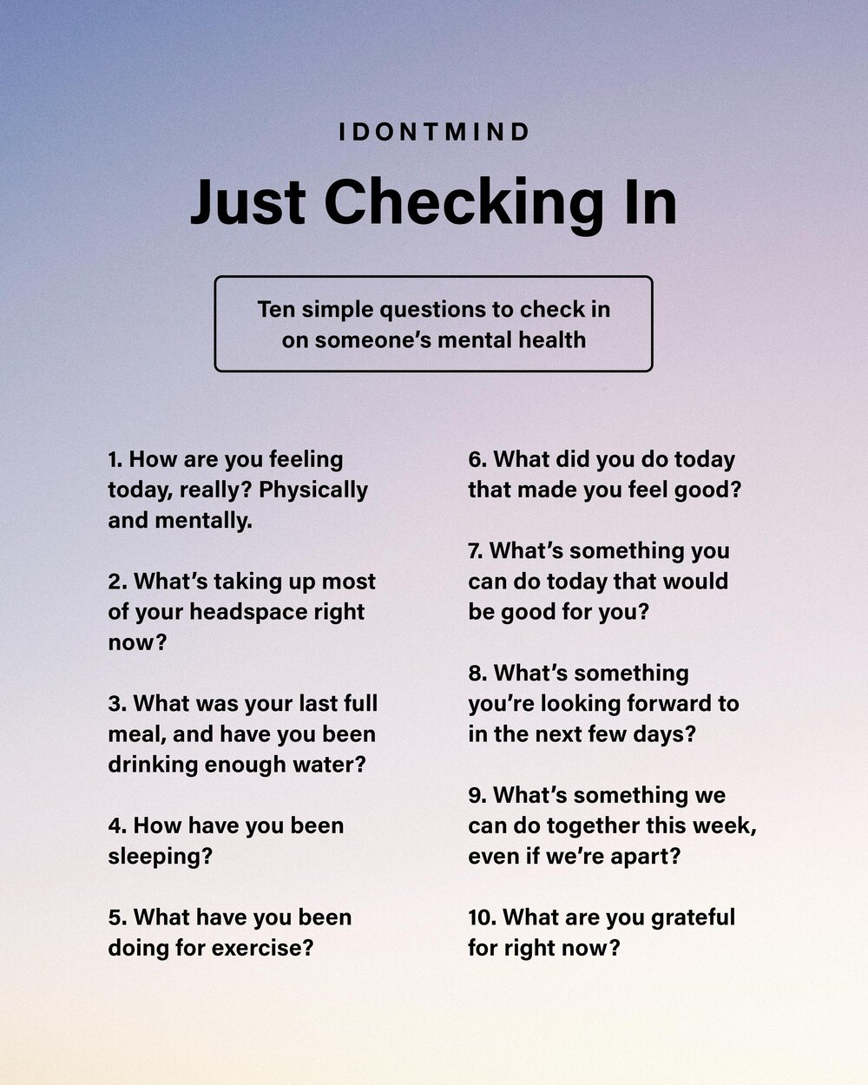
How to start a conversation

Slide 23
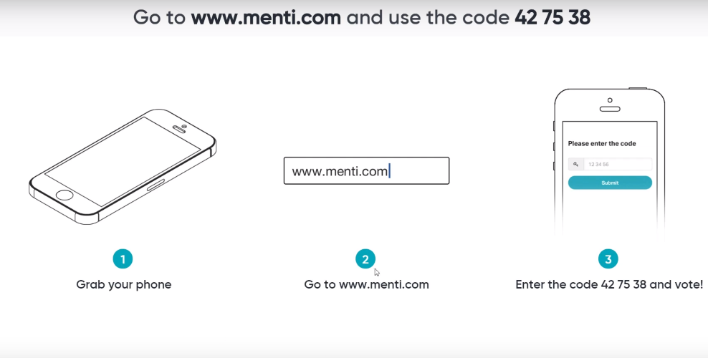
Yes, I am still making you guys participate, but not a traditional question period
24269210
24269210

